Slide 1
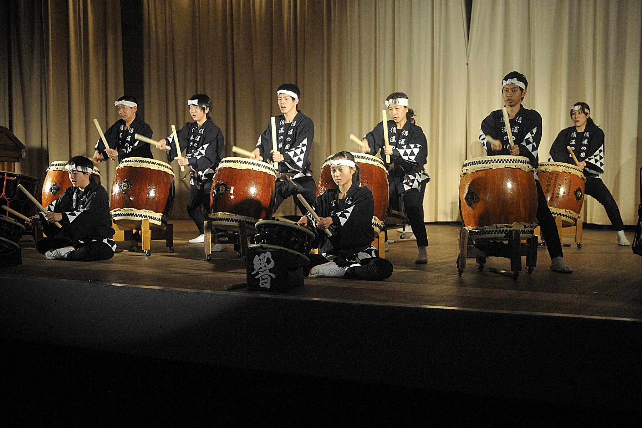
Japanese Taiko Drums
By Loz

Slide 2
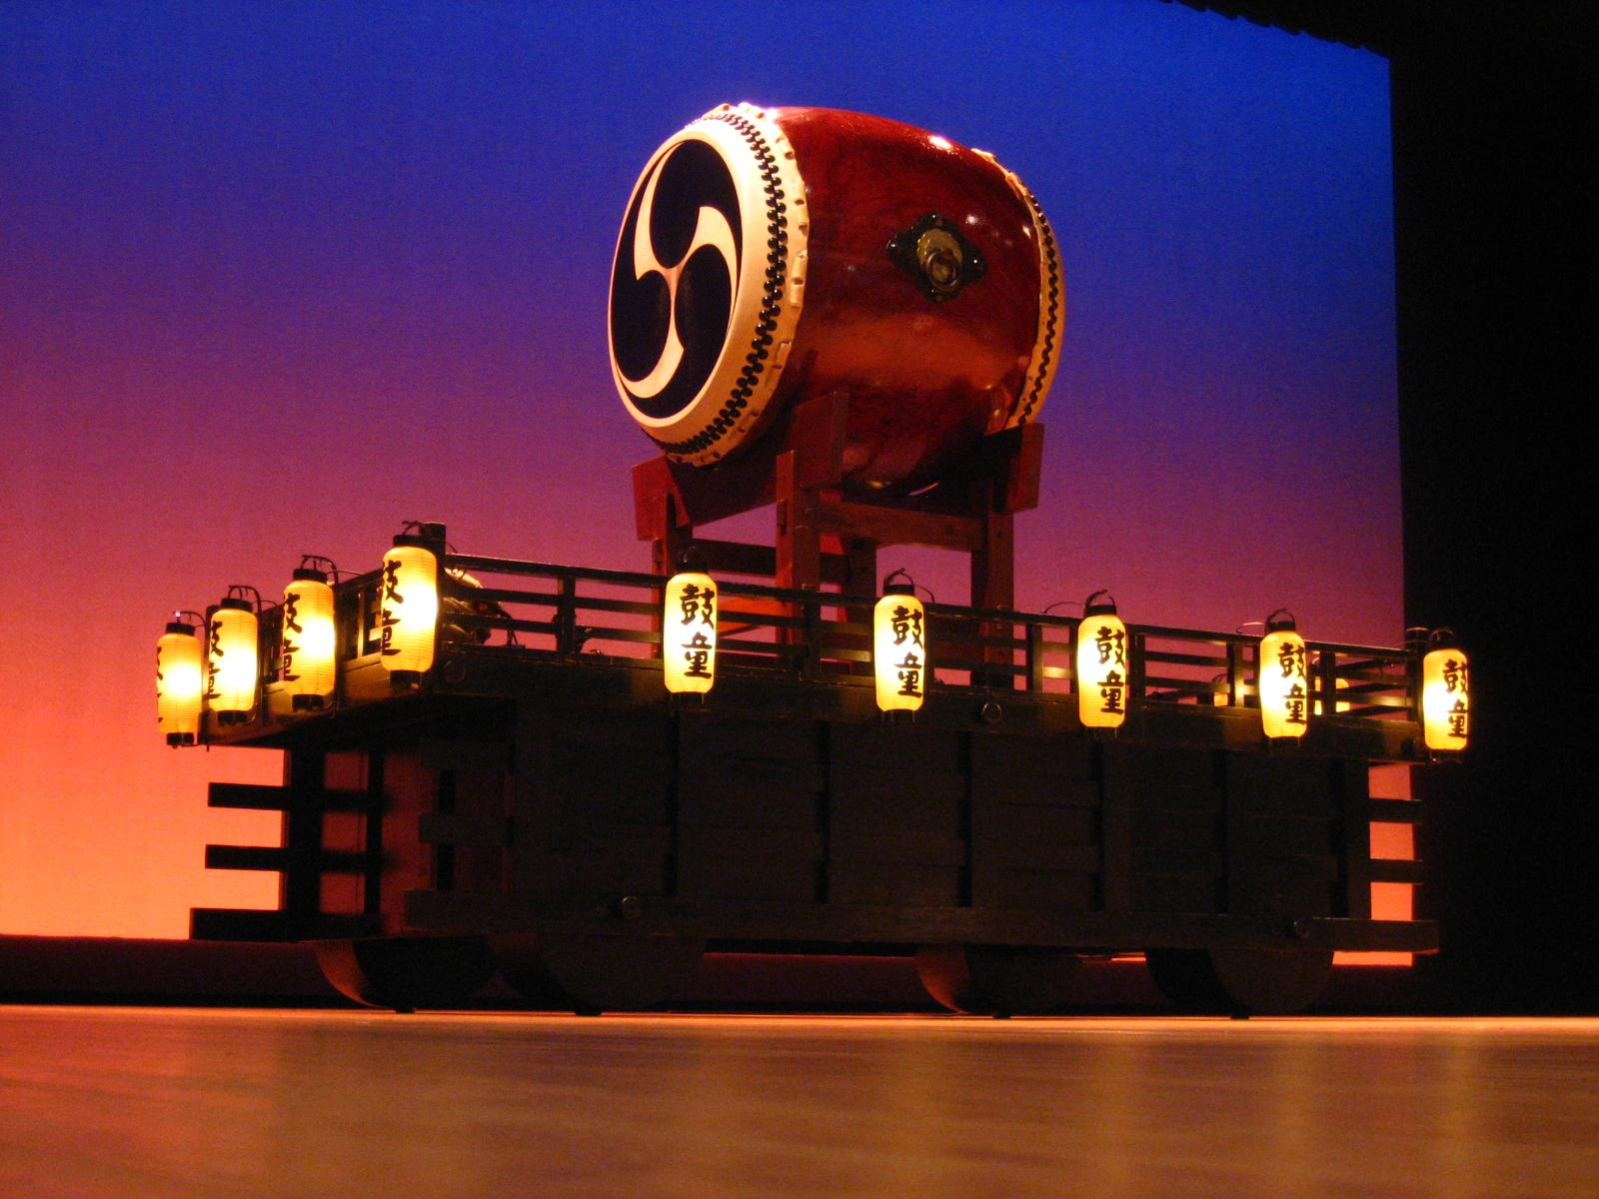
History
Taiko (太鼓) are a broad range of Japanese percussion instruments. In Japanese, the term taiko means any kind of drum.
It has many variants of different Taiko
Taiko Drums a mythological origin in Japanese folklore, Taiko were introduced to Japan through Chinese and Korean cultural influence as early as the 6th century CE; pottery from the Haniwa period depicting taiko drums has also been found.
Daihachi Oguchi was a japanese drummer who invented the Taiko form

Slide 3
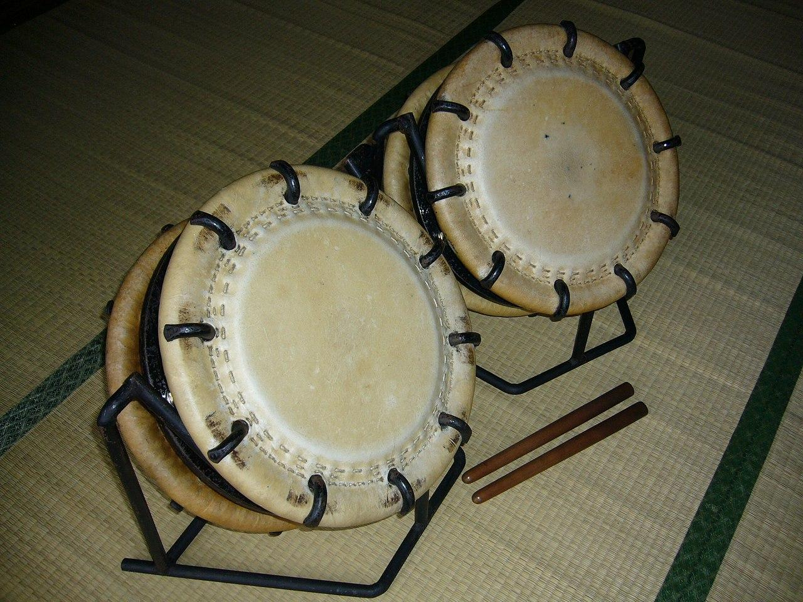
What is Taiko?
Taiko” is a word used to refer to any drum in Japan. A snare drum is a “taiko,” a djembe is a “taiko”. But to the English-speaking world, “taiko” is a term that has come to mean “a traditional style of Japanese drumming”
In short words it is a Japanese shaped drum also a style of many different forms

Slide 4
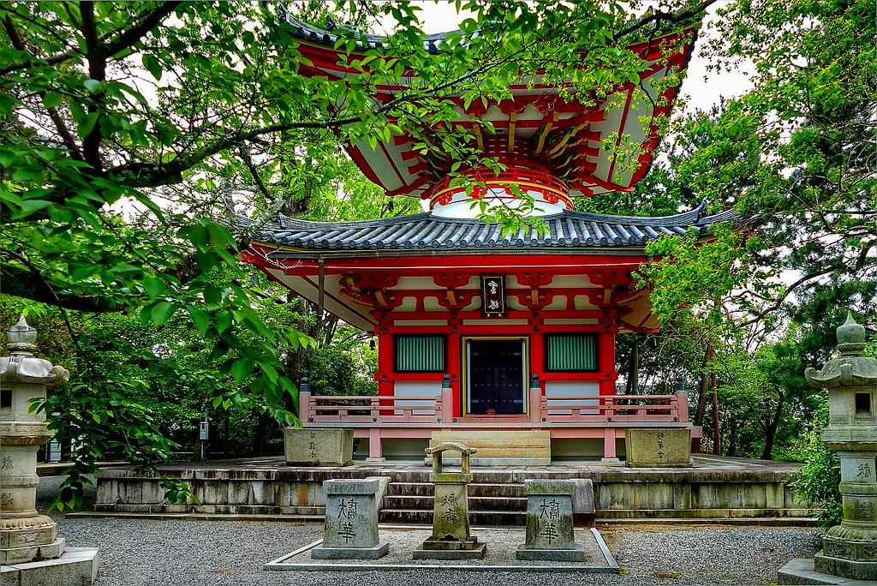
Cultural Importance
“Taiko” also refers to the art of drumming and is claimed to represent the spirit of Japanese people. Since ancient times, Taiko was used in the battlefield during Wars as a protection spell against evil dark forces. Shinto and Buddhist religious ceremonies, festivals, royal courts, and theatrical arts performance. The sacred power of Taiko for Japanese people is difficult to clarify in modern context.

Slide 5
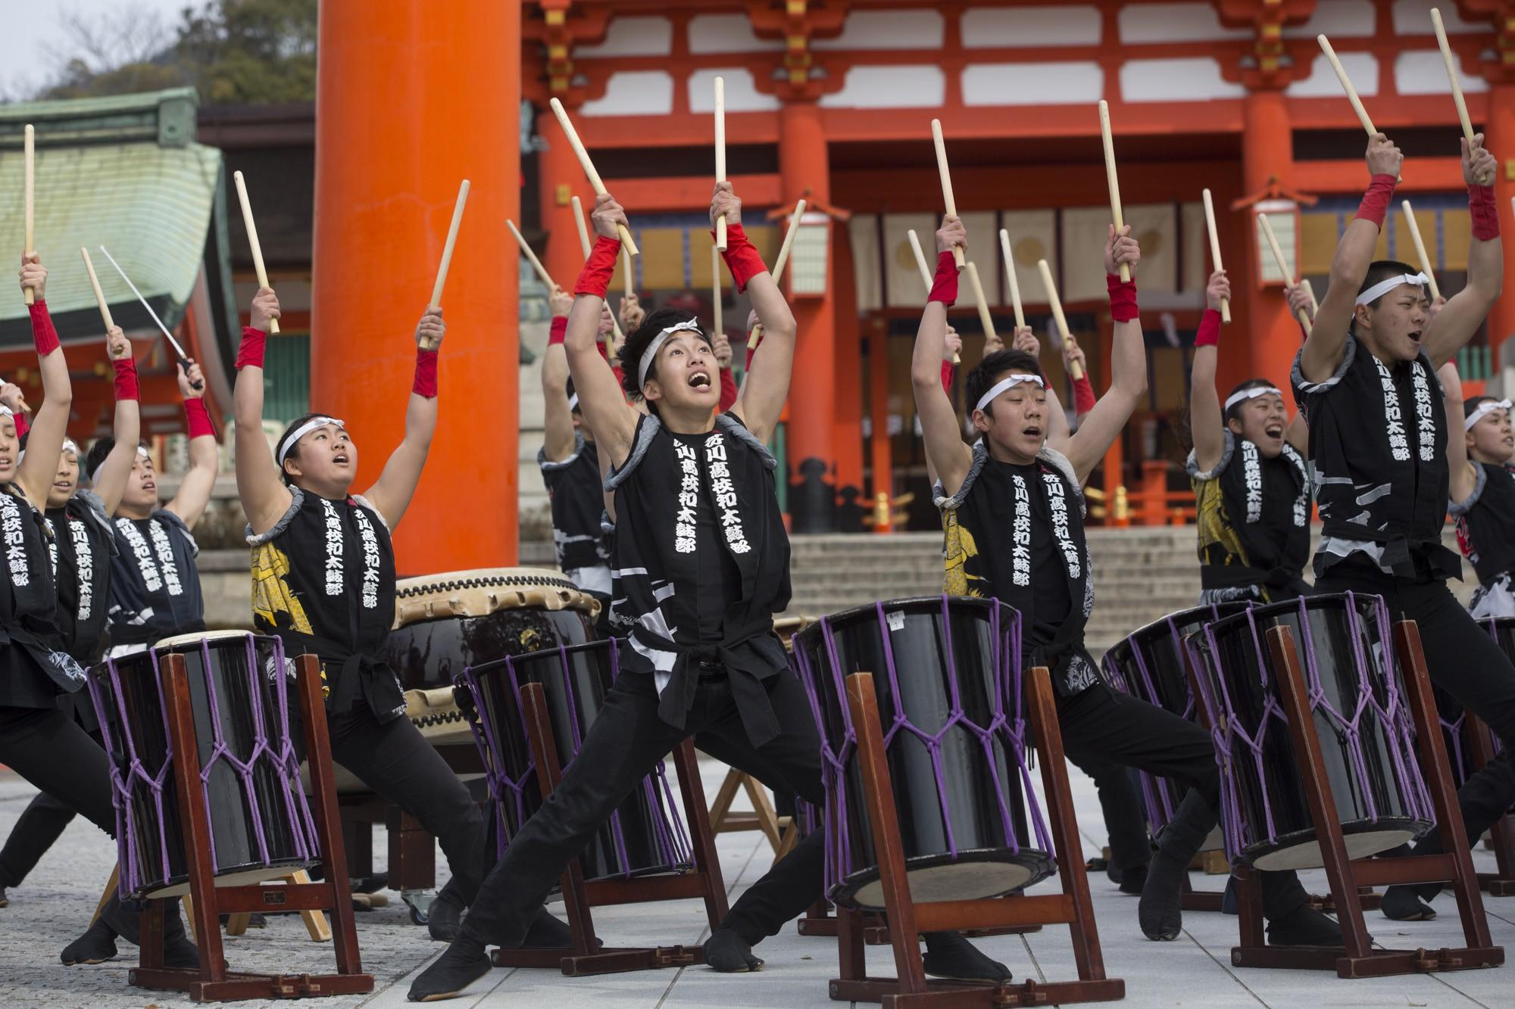
Facts on Japanese Taiko Drum
Taiko drums are handmade by professional drum makers in Japan.
It is believed that the spirit of the trees from which the wood came, as well as the spirit of the builders of the drum, and even the performers who played them over the years come to embody each drum.
Spirits protect Japanese people
Symbol of Culture
A belief that Taiko Protected you on the Battlefield.

Slide 6

Sources + Video + Also life lesson
Sources
https://digscholarship.unco.edu/urj/vol6/iss1/8/#:~:text=%E2%80%9CTaiko%E2%80%9D%20also%20refers%20to%20the,courts%2C%20and%20theatrical%20arts%20performance.
https://www.markhrooney.com/what-is-taiko/
https://www.taiko-center.co.jp/english/history_of_taiko.html#:~:text=Surprisingly%2C%20the%20Kumi%2Ddaiko%20style,was%20actually%20a%20jazz%20drummer.
https://en.wikipedia.org/wiki/Taiko#:~:text=Taiko%20have%20a%20mythological%20origin,drums%20has%20also%20been%20found.
https://www.google.com/search?q=facts+on+japenese+taiko+drum&rlz=1C1GCEU_enUS957US957&oq=facts+on+japenese+taiko+drum&gs_lcrp=EgZjaHJvbWUyBggAEEUYOTIJCAEQIRgKGKABMgkIAhAhGAoYoAEyCQgDECEYChigATIJCAQQIRgKGKsCMgcIBRAhGJ8F0gEIOTYwMWowajeoAgCwAgA&sourceid=chrome&ie=UTF-8&safe=active&ssui=on
Google Image Search
Video
https://www.youtube.com/watch?v=rWxhMwmW2QM
Life Lesson: Buy heated driveways kids

